Slide 1

A Framework For Scientific Summarization
Blake Allen, Priscilla Burity, Derek Topper
https://github.com/blakedallen/summary-of-science/blob/main/AFrameworkForScientificArticleSummarization_BlakeAllen_PriscillaBurity_DerekTopper.pdf

Slide 2
Project description
Literature review is a key step at the beginning of any research project
There are some important differences between summarizing generic texts and scientific articles Teufel and Moens (2020)
Text structure - scientific articles usually starts with an introduction, followed by related works, methodology, etc.
Size - scientific articles are usually much longer than generic texts
Should leverage a network of citations of such articles
In this analysis, we were able to generate abstractive summaries from the text of scientific articles and their citations network using transformers.

Slide 3

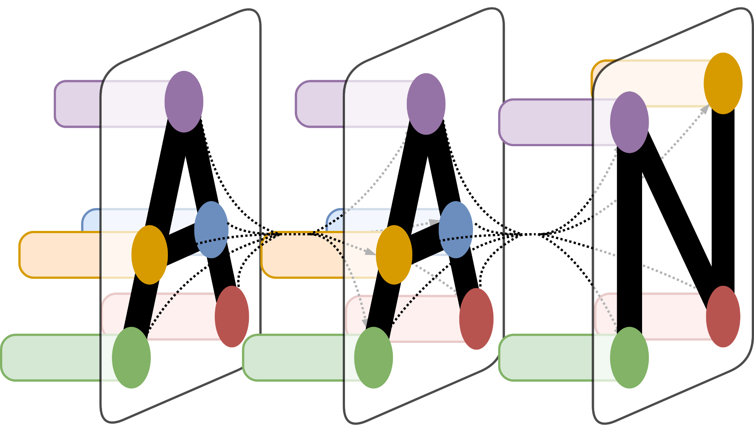

Data
ScisummNet - 1k scientific papers
Arxiv - 600k scientific papers
AAN - 36k scientific papers

Slide 4
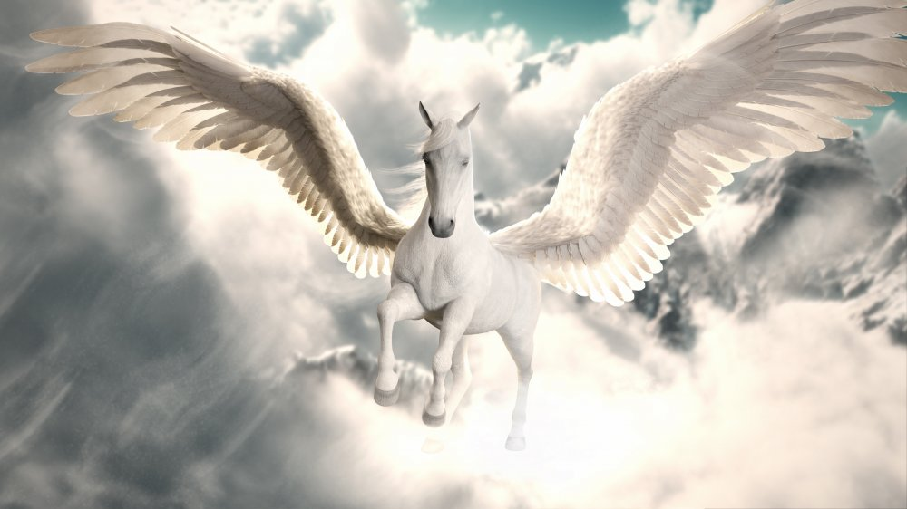
What’s a PEGASUS doing in an NLP Paper (Pegasus Intro)
PEGASUS - Pre-training with Extracted Gap-sentences for Abstractive Summarization
A transformer model that uses self-supervised training to improve abstractive summarization.
Notes:
Pegasus is a model proposed by some guys at Google, the propose pre-training Transformer-based encoder-decoder models on large text corpora with abstractive text summarization as a task
How it works? important sentences are removed/masked from an input document and are generated together as one output sequence from the remaining sentences
>>> Suitable for abstractive summarization as it resembles the downstream task, encouraging whole-document understanding and summary-like generation

Slide 5
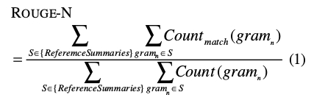
ROUGE Metric
We used Rouge-1, Rouge-2 and Rouge-L (longest subsequence) as our primary scoring metrics.
Notes:
It is a set of metrics and used for evaluating automatic summarization and machine translation. The metrics compare an automatically produced summary or translation against a reference or a set of human produced references. The metric is based overlap of N-grams^{[2]} between the machine's and reference summaries.
Rouge1 refers to the overlap of unigram,

Slide 6

Data Preprocessing - Quality Sentences
Break PDFs and Papers into Abstracts, and Bodies
if available, Citations and Golden Summaries
Use Citations to generate Cited Text Spans
Cited Text Spans are the most similar (ROUGE-1) sentences to the citations
Select good quality sentences
Sentences that met certain quality standards (few symbols, high % of English words)
Select important sentences
Sentences that ALONE have the largest score in the summarizing the body
Notes:
We did a long job in pre-processing the sentences
Break PDFs and Papers into Abstracts, and Bodies
We Used Citations to generate Cited Text Spans - we checked all citations and all sentences in the body and checked which body sentences (the top 3) that have the largest similarity with citations and used it as input
Finally we checked the quality of the sentences (mostly the % of math symbols, but also if the had words like equation x, table x, etc, things that should not be in a summary, but if it's important will be elsewhere in the paper, so our model has an easier time to understand what the paper is about) - so we removed those sentences and
Its the fourth part: picked the first 25, or 50, or 100 most important sentences - Sentences that ALONE have the largest score in the summarizing the body

Slide 7
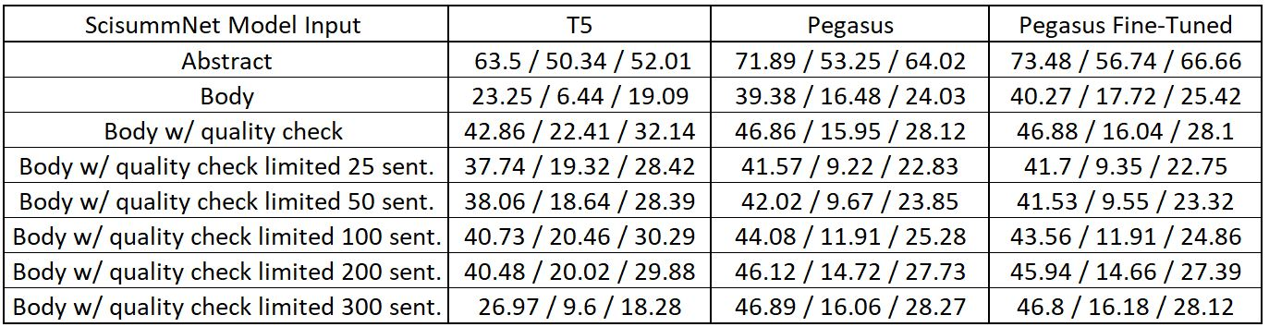
PEGASUS x ScisummNet Data
Rouge-1 / Rouge-2 / Rouge-L
All model inputs include cited text spans
Notes:
Priscilla

Slide 8
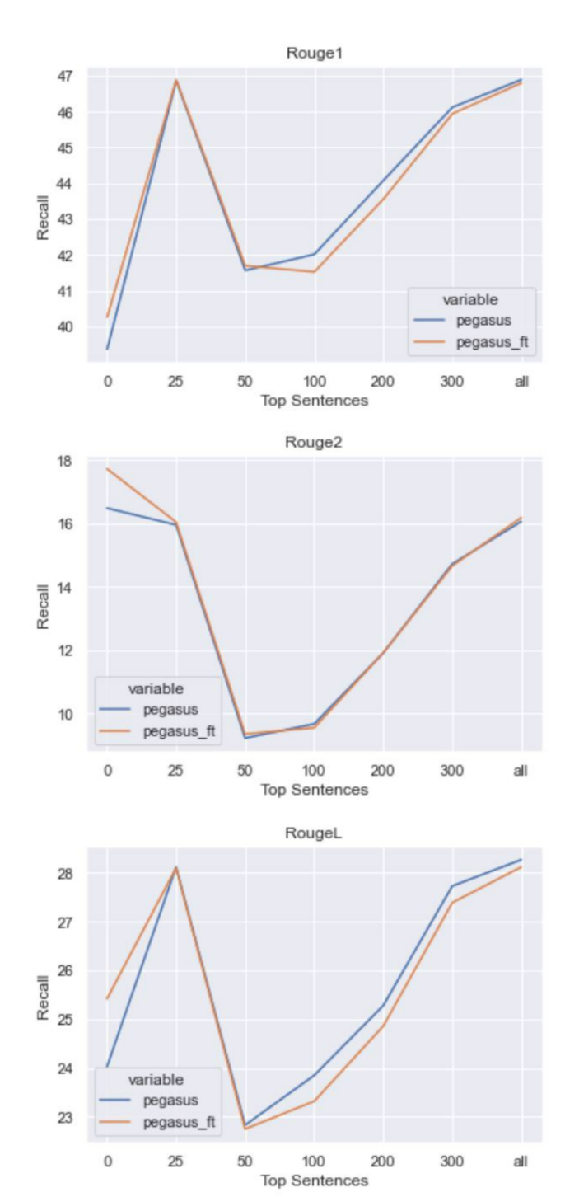
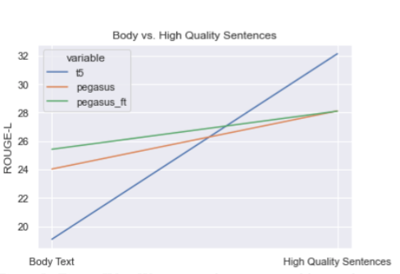
HQS + PEGASUS x ScisummNet Data
Using our ‘High Quality Sentences’ metric we see an increase in Rouge-L scores for all model types.
We also see sharp increase in rouge scores for the top 25 sentences from baseline, indicating that only a small subset of the text is needed for a quality summary.
Notes:
Priscilla

Slide 9
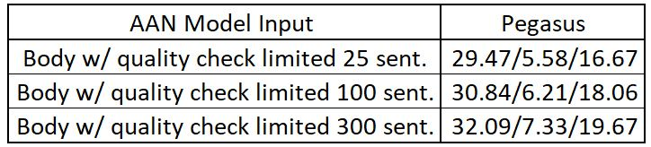
Comparison on AAN Corpus
We then employed the same technique from earlier (quality sentences, and transfer learned our ScisummNet-trained PEGASUS model on the AAN data.
Rouge-1 / Rouge-2 / Rouge-L
All model inputs include cited text spans
Notes:
Derek

Slide 10
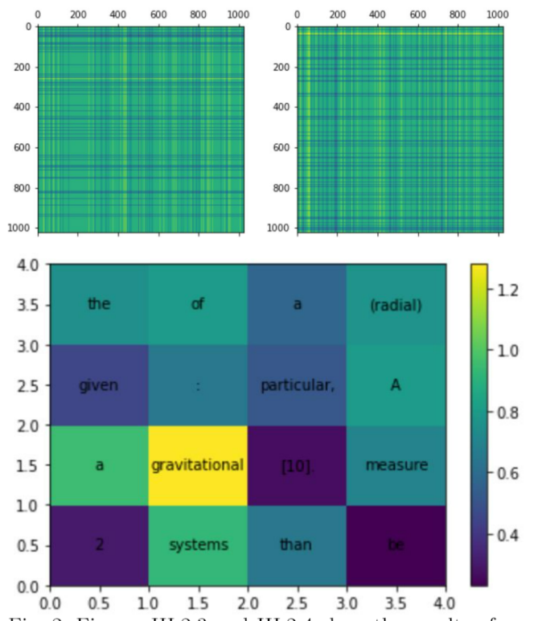
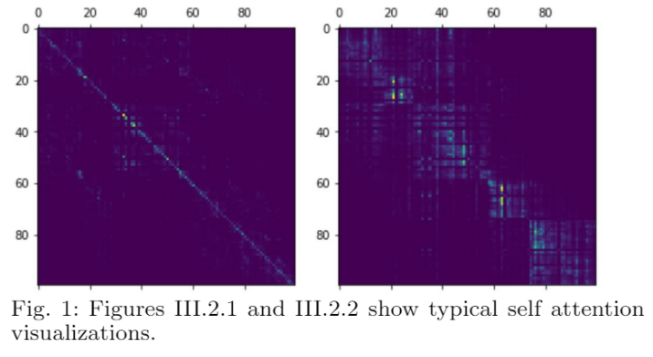
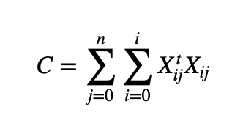
Custom Model - attention mechanism

Slide 11
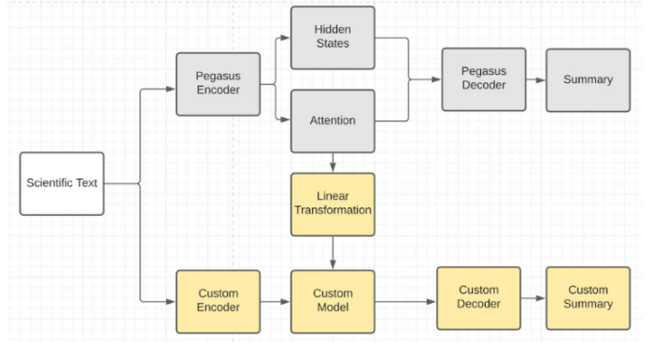
Custom Model

Slide 12
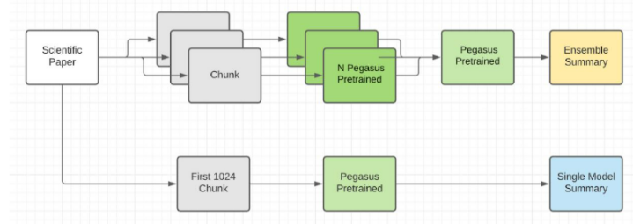
Pegasus Ensemble Approach

Slide 13
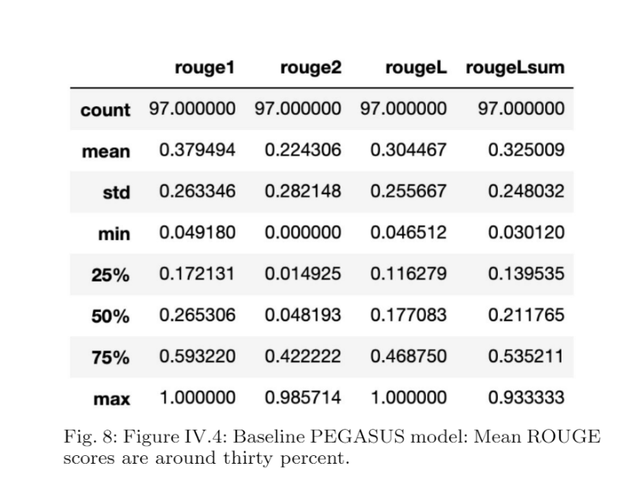
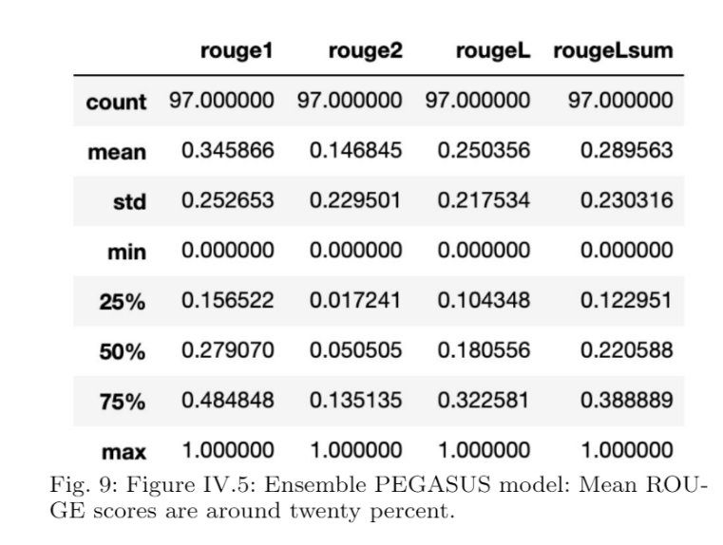
Ensemble Approach

Slide 14
Conclusion
Improvement over baseline performance was demonstrated for all model types using the quality sentences scoring metric for pre-processing.
We noticed a large jump in rouge scores at the 25 sentence mark, leading us to believe that high quality abstractive summarizations can be generated quicker and with less computation using a small subset of the scientific literature text.
Notes:
Derek

Slide 15
References
1] Nouf Ibrahim Altmami and Mohamed El Bachir Menai, “Automatic summarization of scientific articles: A sur-vey.,” Journal of King Saud University - Computer and Information Sciences, 2020.
[2] Travis Goodwin, Max Savery, and Dina Demner Fushman, “Flight of the PEGASUS? comparing transformers on few-shot and zero-shot multi-document abstrac-tive summarization,” inProceedings of the 28th Interna-tional Conference on Computational Linguistics, Barce-lona, Spain (Online), Dec. 2020, pp. 5640–5646, Interna-tional Committee on Computational Linguistics. [3] Virapat Kieuvongngam et al., “Automatic text summa-rization of covid-19 medical research articles using bertand gpt-2.,” 2020. [4] Mike Lewis, Yinhan Liu, Naman Goyal, Marjan Ghaz-vininejad, Abdelrahman Mohamed, Omer Levy, Vese-lin Stoyanov, and Luke Zettlemoyer, “BART: denoisingsequence-to-sequence pre-training for natural languagegeneration, translation, and comprehension,”CoRR, vol.abs/1910.13461, 2019.
[5] Chin-Yew Lin, “ROUGE: A package for automatic eva-luation of summaries,” inText Summarization BranchesOut, Barcelona, Spain, July 2004, pp. 74–81, Associationfor Computational Linguistics.
[6] Elena Lloret and Manuel Palomar Mar ́ıa Teresa Rom ́a-Ferri, “Compendium: a text summarization system forgenerating abstracts of research papers,”InternationalConference on Application of Natural Language to In-formation Systems, Springer, pp. 3–14, 2011.
[7] Qiaozhu Mei and ChengXiang Zhai, “Generating impact-based summaries for scientific literature,”Proceedings ofACL-08: HLT: 816–824, 2008.
[8] Thang Pham et al., “Out of order: How important isthe sequential order of words in a sentence in naturallanguage understanding tasks?,” 2012.
[9] Vahed Qazvinian and DragomirR Radev, “Scientific pa-per summarization using citation summary networks,”Proceedings of the 22nd International Conference onComputational Linguistics-Volume 1, pp. 689–696, 2008.
[10] Dragomir R Radev, Pradeep Muthukrishnan, Vahed Qaz-vinian, and Amjad Abu-Jbara, “The acl anthology net-work corpus,”Language Resources and Evaluation, pp.1–26, 2013.
[11] Colin Raffel, Noam Shazeer, Adam Roberts, KatherineLee, Sharan Narang, Michael Matena, Yanqi Zhou, WeiLi, and Peter J. Liu, “Exploring the limits of transferlearning with a unified text-to-text transformer,” 2020.
[12] Sandeep Subramanian, Raymond Li, Jonathan Pilault,and Christopher J. Pal, “On extractive and abstractiveneural document summarization with transformer lan-guage models,”CoRR, vol. abs/1909.03186, 2019.
[13] Simone Teufel and Marc Moens, “Summarizing scien-tific articles: Experiments with relevance and rhetoricalstatus,” 2002.
[14] Michihiro Yasunaga et al., “Scisummnet: A large an-notated corpus and content-impact models for scientificpaper summarization with citation networks,”Procee-dings of the AAAI Conference on Artificial Intelligence,vol. 33, p. 7386–7393, 2019.
[15] Jingqing Zhang et al., “Pegasus: Pre-training with ex-tracted gap-sentences for abstractive summarization,”2020
Notes:
Derek

Slide 16
Thank you
Notes:
Derek

